Slide 1
UBSUP - DTF project - KENYA Maintenance of a co-composting facility

Slide 2
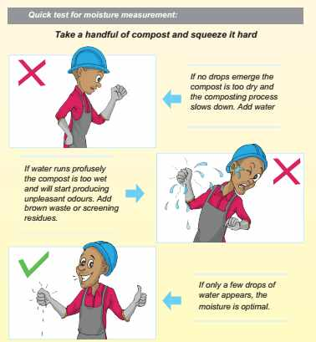
Moisture control User’s guide page 11
Moisture content should be maintain between 40 to 60%

Slide 3
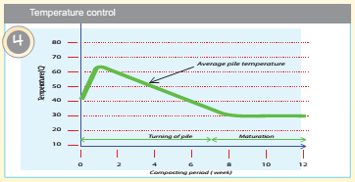
Temperature control User’s guide page 10 and 11
1st week: temperature rises quickly up to 65°C
Next 6 weeks: temperature decreases gradually up to ambient temperature
Next 4 weeks: temperature stabilize at ambient temperature

Slide 4
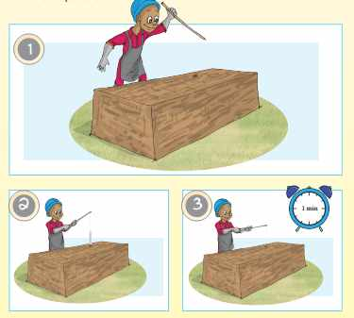
Temperature control User’s guide page 10 and 11
Steps:
Push a hole in the middle of the windrow with a stick
Attach a thermometer to a stick with a piece of string
Insert thermometer in the hole and leave it for 1 minute
Read the temperature and monitor with the diagram
Read temperature:
Daily during the first week
Then 2 to 3 times per week

Slide 5
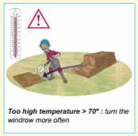
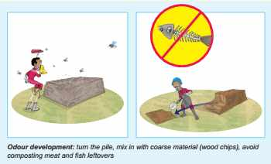
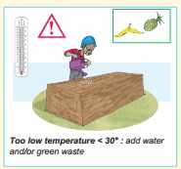
Trouble shooting: composting parameters User’s guide page 16
Temperature:
Odour:

Slide 6
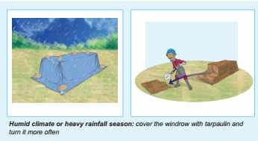
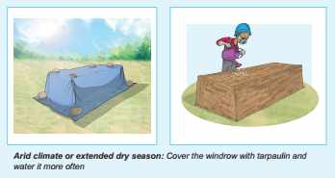
Trouble shooting: climatic influences and vectors User’s guide page 17

Slide 7
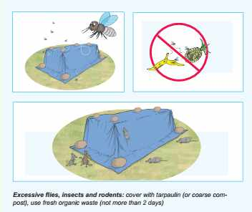
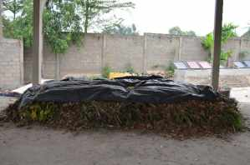
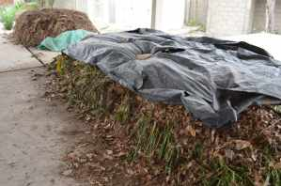
Trouble shooting: climatic influences and vectors User’s guide page 18

Slide 8
Do you have any questions, remarks or suggestions?

